Slide 1

Battle of Neighborhood

Slide 2
Your best quote that reflects your approach… “It’s one small step for man, one giant leap for mankind.”
- Neil Armstrong

Slide 3
Introduction
The purpose of this Capstone Project is to help people in exploring better facilities around their neighborhood. It will help people making smart and efficient decision on selecting great neighborhood out of numbers of other neighborhoods in Scarborough, Toronto.
This Capstone Project aim to create an analysis of features for a people migrating to Scarborough to search a best neighborhood as a comparative analysis between neighborhoods. The features include median housing price and better school according to ratings, crime rates of that particular area, road connectivity, weather conditions, good management for emergency, water resources both freash and waste water and excrement conveyed in sewers and recreational facilities.

Slide 4
Data Section
Data Link: https://en.wikipedia.org/wiki/List_of_postal_codes_of_Canada:_M
Will use Scarborough dataset which we scrapped from wikipedia on Week 3. Dataset consisting of latitude and longitude, zip codes.
Foursquare API Data:
We will need data about different venues in different neighborhoods of that specific borough. In order to gain that information we will use “Foursquare” locational information. Foursquare is a location data provider with information about all manner of venues and events within an area of interest. Such information includes venue names, locations, menus and even photos. As such, the foursquare location platform will be used as the sole data source since all the stated required information can be obtained through the API.

Slide 5
Data Section
The data retrieved from Foursquare contained information of venues within a specified distance of the longitude and latitude of the postcodes. The information obtained per venue as follows:
Neighborhood
Latitude
Longitude
Venue
Name
Venue ( Longitude , Latitude and Category)

Slide 6
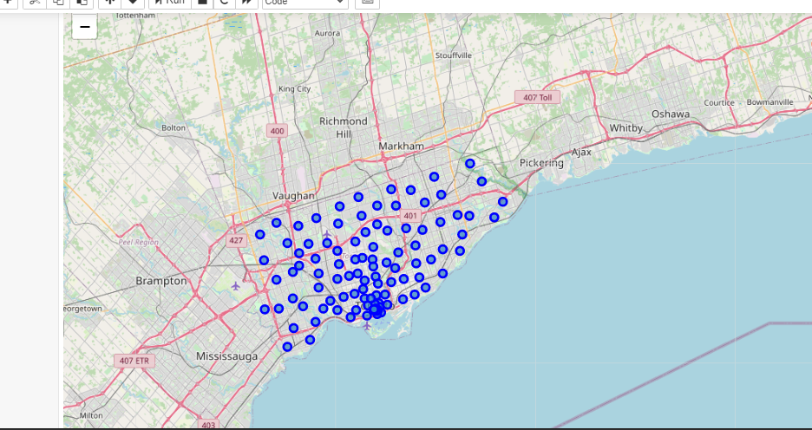
Map of Scarborough

Slide 7
Clustering
To compare the similarities of two cities, we decided to explore neighborhoods, segment them, and group them into clusters to find similar neighborhoods in a big city like New York and Toronto. To be able to do that, we need to cluster data which is a form of unsupervised machine learning: k-means clustering algorithm.
Using K-Means Clustering Approach | Most Common Venue

Slide 8
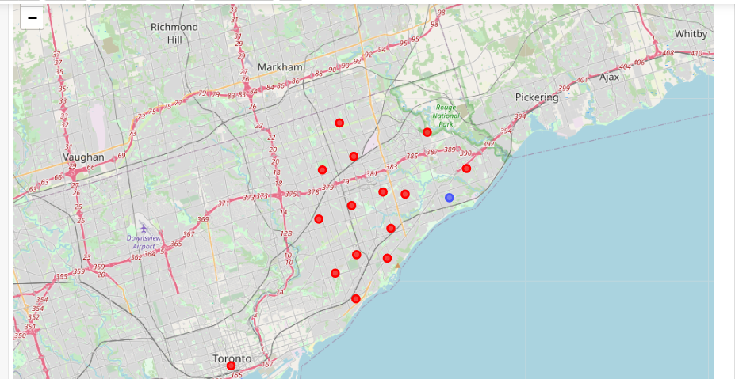
Map of Cluster in Scarborough

Slide 9
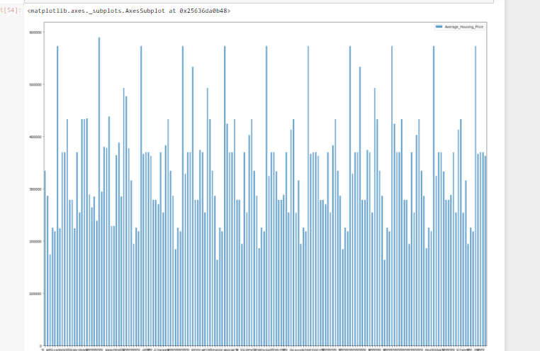
Average Housing Price by Cluster

Slide 10
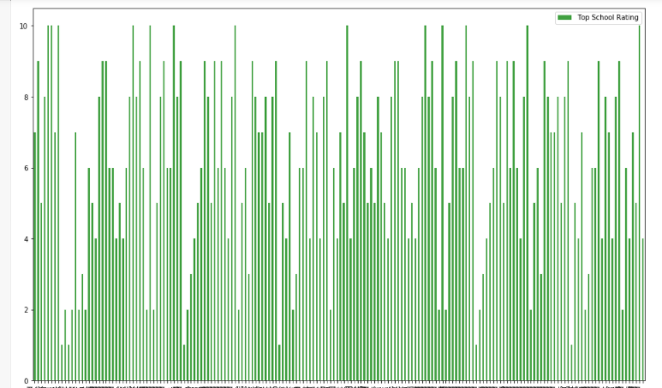
Average School Rate

Slide 11
Future Aspects
This Capstone project can be continued for making it more precise in terms to find best house in Scarborough. Best means on the basis of all required things(daily needs or things we need to live a better life) around and also in terms of cost effective.

Slide 12
Conclusion
The major purpose of this project, is to suggest a better neighborhood in a new city for the person who are shifting there. Social presence in society in terms of like minded people. Connectivity to the airport, bus stand, city center, markets and other daily needs things nearby.
In this Capstone project, using k-means cluster algorithm I separated the neighborhood into 10(Ten) different clusters and for 103 different lattitude and logitude from dataset, which have very-similar neighborhoods around them. Using the charts above results presented to a particular neighborhood based on average house prices and school rating have been made.

